Slide 1


ASKCOS open-source, data-driven synthesis planning
Zhengkai Tu, MIT EECS
April 10, 2025
For the slides
For the manuscript
Notes:
Good afternoon, everyone. My name is Zhengkai.
Today I’m going to present ASKCOS, which is an open-source web application for data-driven synthesis planning, that our group has been developing since 2017.
I’ve put up the QR codes for the slides on the left and for the associated manuscript on the right; please feel free to scan.
The general intention of ASKCOS is to put together research advances in the field, into a practical tool for any chemists or chem informaticians to use.
I will first talk about the data-driven part, briefly introducing the task of synthesis planning and how its elements can be formulated as machine learning problems.
And then I will move on to the open-source part, discussing the design and implementation of ASKCOS at a high level.

Slide 2
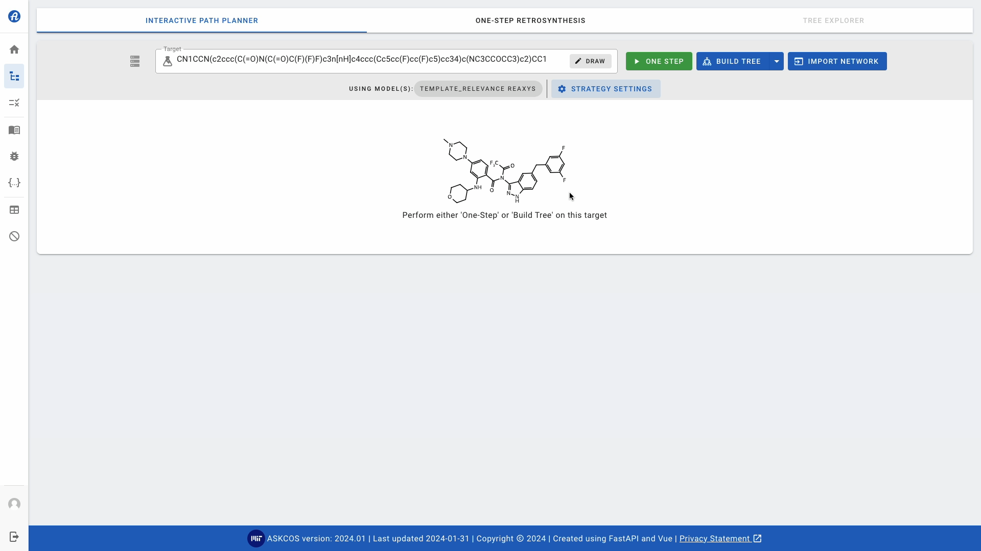
ASKCOS has a GUI and supports interactive planning
On a typical
desktop w/
Intel i7-12700
~$1000
Notes:
We will start with a quick demo showing the basic usage of ASKCOS.
(Start the clip) We start from the interactive planning canvas with some moderately complex target, click ONE STEP, double click the intermediate of interest to expand, and do it again.
Here the ASKCOS app was hosted on a modern-day desktop which you can buy for a thousand dollars.
And each expansion takes as few as 2-3 seconds on this machine.

Slide 3
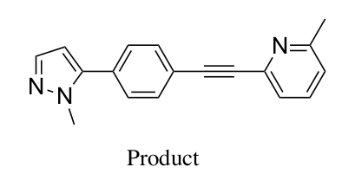
ASKCOS is a synthesis planning tool
Try it: askcos.mit.edu
Retrosynthetic analysis
given the target, propose precursors
？
Notes:
Formally, ASKCOS is an open-source tool for synthesis planning, which is a broad category of approaches for selecting experimental procedures and protocols that produce a target molecule.
A central technique in synthesis planning is retrosynthetic analysis, which proposes reaction precursors for given targets.

Slide 4
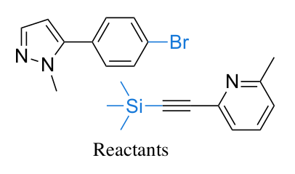
ASKCOS is a synthesis planning tool
Try it: askcos.mit.edu
Retrosynthetic analysis
given the target, propose precursors
iteratively, until reaching buyables
？
Notes:
- And we perform this process iteratively, breaking down the target into smaller and smaller pieces, until reaching buyable building blocks.

Slide 5
ASKCOS is a synthesis planning tool
Try it: askcos.mit.edu
Retrosynthetic analysis
given the target, propose precursors
iteratively, until reaching buyables
Reaction context recommendation
Temperature, catalysts, etc
Amount of reagents
？
Reaction outcome prediction
Likelihood of success
Impurities
Selectivity
Notes:
While multi-step retrosynthetic analysis aims to suggest synthesis routes with different building blocks and intermediates,
it is also crucial to recommend the context for each reaction step, including but not limited to temperature, catalysts, solvent, and the amounts of reactants and reagents.
Another important question to be answered in synthesis planning is the reaction outcome, such as the likelihood of success, potential impurities, and selectivity.

Slide 6
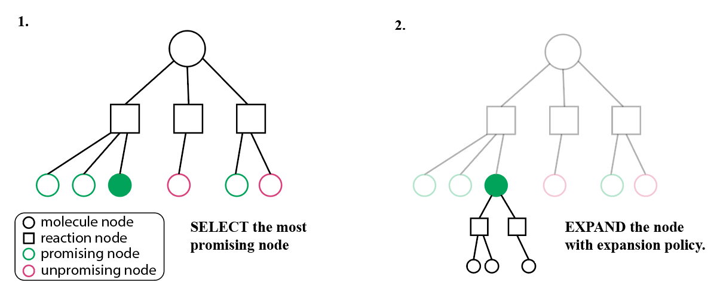
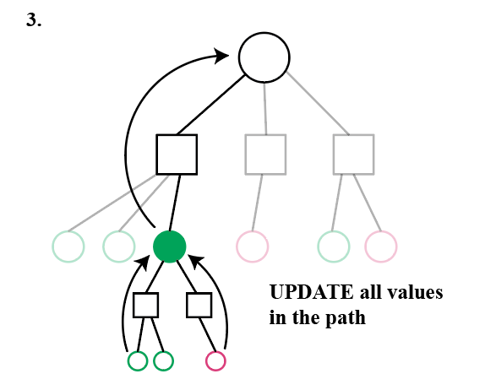
Synthesis planning can be formulated as tree search
(optionally) with pruning and/or filtering
Notes:
The synthesis planning process can be naturally formulated as a tree search problem with the target as the root node.
In each step of the planning, it then selects the most promising node (as in step 1), expand the node (as in step 2), and then updates the states of all nodes along the path depending on whether the new nodes are accessible.
The search process repeats until a viable pathway with buyable building blocks is found, or until some termination criteria is reached.
Optionally, the search tree can be pruned or filtered during or after the search, using evaluation metrics such as heuristic scores or other machine learning models.

Slide 7
Tree search elements can be data-driven
For selection: learned value functions, GNN-based selection policies
For expansion: one-step precursor proposal, reranking
For evaluation: condition recommendation, outcome prediction
Notes:
Various elements in this tree search process can be formulated as machine learning prediction, with the right and hopefully good-quality data of course.
For selection, the value function for selecting the most promising node can be machine learned. Or even the selection policy itself can be learned, for example, with graph neural networks to predict the best node given the partial search tree.
For expansion, or equivalently, one-step retrosynthesis, various approaches have been developed for proposing the precursors or reranking the reactions after.
For evaluation, at the one-step level, machine learning models have shown their power for condition recommendation and outcome prediction.
Evaluation at the pathway level is more challenging but not impossible, and one way is to train a machine learning predictor to differentiate patent-extracted and artificial pathways, and thereby generating a score for literature-likeness.
Due to time constraint, I will mostly elaborate on some formulations for expansion, which are more or less generalizable to the other tree search elements.

Slide 8
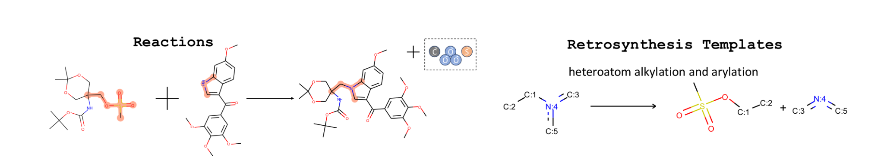
Template-based models offer traceability
Predict best template(s)
source: GLN²
Notes:
So for expansion, or one-step retrosynthesis, it aims to propose possible reactants, given the target product or intermediate.
There are a few ways to categorize various approaches for one-step retrosynthesis, and one way is based on whether and how much of reaction templates are used in the formulation.
Let’s start with template-based methods, which do make use of the full reaction templates,
or essentially reaction rules that summarize the transformation as patterns.
For example, for the alkylation and arylation reaction shown in the diagram, we can extract the patterns highlighted in orange on the left, into the retro template on the right.
The model is then trained to select the best templates for new molecules.

Slide 9
Template-based models offer traceability
Predict best template(s)
Generality/specificity tradeoff
Can’t generalize to unseen templates
source: GLN²
Notes:
Template-based methods generally offer some traceability, because any template, in most implementations, has their literature precedents as references.
However, the intrinsic limitations of these methods are that there is always a tradeoff between how specific and how general we should define the template.
If the template is too general, it probably can’t capture much information that’s practically useful; if it’s too specific, we can have too many templates which would make it harder for the model to learn.
And, they typically can’t generalize to unseen templates.

Slide 10
Template-based models offer traceability
Predict best template(s)
Generality/specificity tradeoff
Can’t generalize to unseen templates
Can also be retrieval-based³
source: GLN²
Notes:
It’s worth noting that template-based methods can also be retrieval-based, which retrieve and then apply the templates associated with most similar targets in the database.

Slide 11
Template free models may generalize better
Seq2seq, graph2seq, graph2graph
e.g., SMILES-to-SMILES translation with SLM
Transformer⁴
Graph2SMILES⁵
SMILES Output
SMILES Output
Transformer Encoder
Transformer Decoder
Graph Encoder
Transformer Decoder
SMILES input
Graph input
Notes:
To get around the intrinsic limitations, researchers have come up with various template-free approaches,
with seq2seq, graph2seq, or graph2graph modeling.
For example, by formulating it as a SMILES-to-SMILES translation, with SLM or small language models, such as the Transformer.
As we can see in the schematic on the left, the baseline Transformer model uses a Transformer encoder to encode SMILES input into their representation vectors,
based on which the Transformer decoder generates the output SMILES.
There can be multiple variants by switching the representation and the encoder block, in particular, we developed this Graph2SMILES model on the right a few years ago,
by using molecular graph input with a graph encoder to enhance performance.

Slide 12
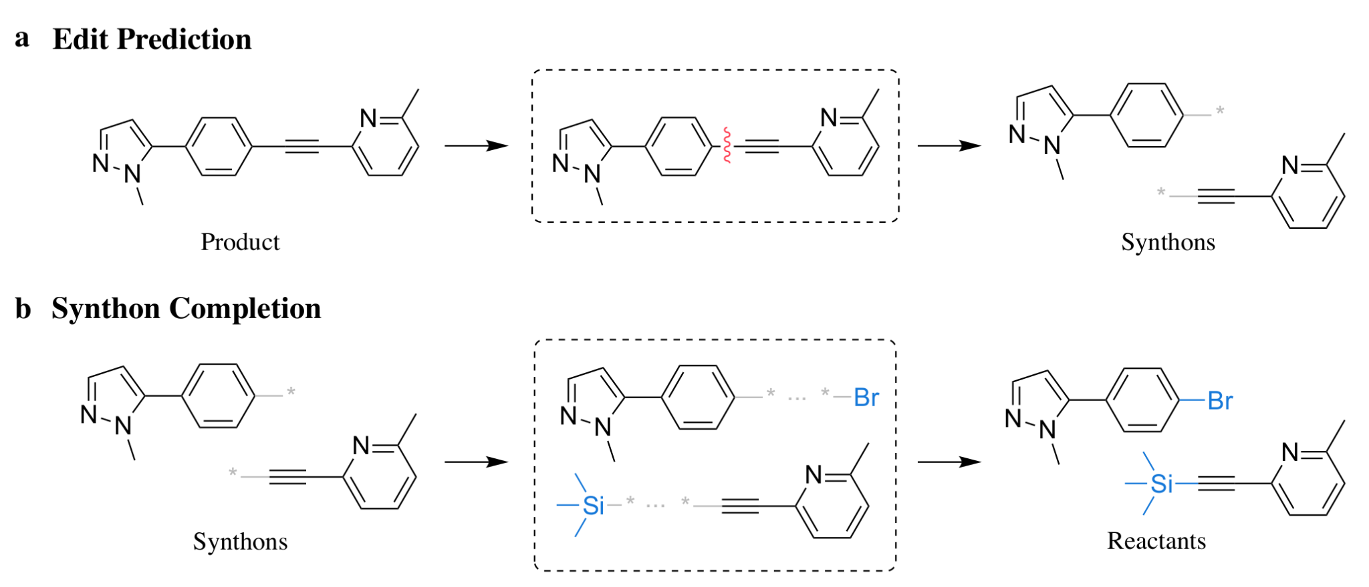
Additional features or alternative formulation may help
E.g., atom-mapping, reaction centers
In particular, semi-template based methods use the synthon approach
source: GraphRetro⁶
Notes:
There are also methods that are in between, which, without loss of generality, make use of additional features such as atom-mapping and reactions centers.
In particular, semi-template based methods formulate retrosynthesis as a single graph edit to break the product into hypothetical reaction intermediates called synthons.
After which, a second model is trained to recover the full reactants, for example, by attaching the right leaving groups.
These are trained on the same reaction data as template-based and template-free models are, but with the information of the reaction centers which are heuristically computed based on atom mapping, and generally with RDKit.

Slide 13
Models are typically evaluated by top-k accuracy
=> percentage of ground truths appearing in top-k predictions
On benchmarking datasets:
- publicly available: USPTO-50k, USPTO-full
- proprietary: Pistachio⁷, CAS⁵, in-house data⁸
Limitation:
retrosynthesis can be subjective; ground truths not necessarily the best
Notes:
The performance of these one-step retrosynthesis models are generally evaluated using top-k accuracy, or the percentage of ground truths appearing in top-k predictions, which is really a recall.
Public benchmarking datasets are generally derived from USPTO, or reactions in US patents, while some works do evaluate on proprietary datasets like Pistachio, CAS contents, and in-house data.
The top-k accuracy has its own limitation as an evaluation metric, as it does not take into account the subjective nature of retrosynthesis. But it’s still the most widely used metric, as its computation is cheap and unambiguous.

Slide 14
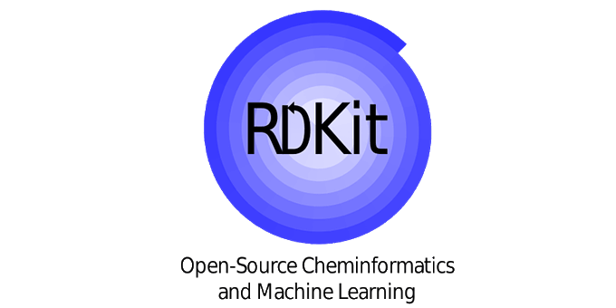
Almost everyone uses RDKit
Especially for featurization:
- fingerprint generation
- SMILES canonicalization, augmentation, alignment
- molecular graph feature computation
For more complex processing in ASKCOS:
- drawing
- template extraction and application
- alignment between product and reactant graphs
Notes:
Almost everyone doing data-driven retrosynthesis uses RDKit, especially for featurization.
For one-step retrosynthesis and many other predictive chemistry tasks, molecular inputs are mostly featurized as fingerprints, SMILES strings, or molecular graphs.
RDKit can do all, by computing the fingerprints or atom and bond features for the molecular graph.
And it has also been very helpful in generating canonical SMILES, as well as equivalent SMILES for augmentation which has been a known performance engineering technique, and aligning atoms between molecule and SMILES for later use.

Slide 15
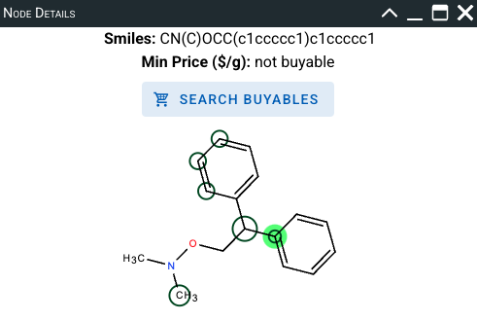
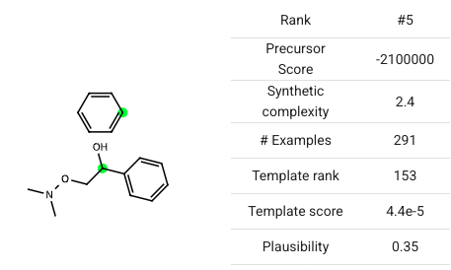
Almost everyone uses RDKit
Especially for featurization:
- fingerprint generation
- SMILES canonicalization, augmentation, alignment
- molecular graph feature computation
For more complex processing in ASKCOS:
- drawing
- template extraction and application
- alignment between product and reactant graphs
Notes:
I’ve just checked yesterday and can confirm that every single predictive model in ASKCOS uses RDKit.
It’s also central for other capabilities in ASKCOS such as drawing which uses RDKit almost exclusively, very powerful.
Or template extraction and application.
And another specific RDKit-enabled feature in ASKCOS is to filter proposed precursors by clicking on the reaction center.
As shown on the bottom right, clicking on the aryl carbon (highlighted in green), keeps only the precursors with that carbon at the reaction center.
This feature relies mostly on RDKit-computed alignment between product and reactant graphs, which helps maintain a universal atom mapping with respect to the target.

Slide 16
Other synthesis planning tasks are similar
Given some molecules or reactions, predict molecules and/or values
Condition recommendation:
- Given reactants and products, predict reagent(s), solvent(s) and T
- E.g., sequential or one-shot prediction
Notes:
Other tasks in synthesis planning are arguably similar to one-step retrosynthesis at a very high level, in terms of formulation as data-driven, machine learning problems.
The inputs are typically some molecules or reactions, featurized as fingerprints or SMILES or graphs, to predict some output molecules and/or values.
For condition recommendation, one way to formulate is sequential or one-shot prediction of the reagent(s), solvent(s) and temperature, given the reactants and products.

Slide 17
Other synthesis planning tasks are similar
Given some molecules or reactions, predict molecules and/or values
Condition recommendation:
- Given reactants and products, predict reagent(s), solvent(s) and T
- E.g., sequential or one-shot prediction
Major product prediction:
- One-step retrosynthesis in the reverse direction
- More objective
- Somewhat dominated by template free approaches
Notes:
For major product prediction which is a simplified task for reaction outcome prediction,
it can be formulated to predict the target molecule given the reactants, or essentially one-step retrosynthesis in the reverse direction.
Different tasks have their own characteristics and considerations, of course.
For example, despite being reverse retrosynthesis, major product prediction happens in the forward direction and is hence more objective and deterministic, whereas retrosynthesis is more of a one-to-many task for which there can be multiple ways of making the same target.
The benchmarking datasets are different which can lead to different techniques and trends. In particular, forward prediction is somewhat dominated by template free approaches, possibly because the benchmarking dataset is larger and large enough to work well for something like a Transformer-based small language model.

Slide 18
Many modules in ASKCOS are data-driven
Partial list of references:
Monte-Carlo tree search: Segler et al. Nature 2018, 555(7698), 604-610.
Retro* search: Chen et al. In ICML 2020, PMLR 119:1608-1616.
One-step retro, template-relevance model: Segler and Waller. Chem. Eur. J. 2017, 23, 5966.
One-step retro, similarity-based model: Coley et al. ACS Cent Sci. 2017, 3(12), 1237-1245.
One-step retro, Transformer: Tetko et al. Nat. Commun. 2020, 11(5575).
One-step retro, Graph2SMILES: Tu and Coley. J. Chem. Inf. Model. 2022, 62(15), 3503-3513.
Condition recommendation: Gao et al. ACS Cent. Sci. 2018, 4(11), 1465-1476.
Outcome prediction: Coley et al. Chem. Sci. 2019, 10, 370-377.
Regio-selectivity prediction: Guan et al. Chem. Sci. 2021, 12, 2198-2208.
Site-selectivity prediction: Struble et al. React. Chem. Eng. 2020, 5, 896-902.
Solubility prediction: Vermeire et al. JACS. 2022, 144(24) 10785–10797.
Disclaimer: I don’t trust all predictions
Notes:
Here we can see a partial list of references here, for a number of data-driven modules in ASKCOS, which have all been developed after 2017.
ASKCOS provides two tree search algorithms, Monte-Carlo tree search and Retro* search, four models for one-step retrosynthetic expansion, and a few other predictors.
This was only made possible with the tremendous benefit the field received from the advancement in machine learning and data-driven methods, and to reiterate,
it is our intention to turn these ground-breaking research on paper into practically usable features in ASKCOS for everyone to use.
This is of course not to say that the predictions are perfect. Like ChatGPT, ASKCOS modules can sometimes hallucinate or do alchemy.
While ASKCOS serves as a platform to showcase the power of latest models, it’s always recommended to make your own judgement about the predictions.

Slide 19
ASKCOS is open-source and deployable with five lines
$ mkdir ASKCOSv2 $ cd ASKCOSv2 $ git clone git@gitlab.com:mlpds_mit/askcosv2/askcos2_core.git $ cd askcos2_core $ make deploy
Clone and deploy (with one command), essentially
Behind the scene: clone other repos, download data/models, build docker environments, start containerized services
Notes:
Now let’s shift gear a bit towards the open-source part of ASKCOS.
First and foremost, ASKCOS is designed for local deployment, which is one of the exact intentions of open-sourcing. All you need is the five lines here,
which is really just cloning the core repository, and then deploy with one command, make deploy.
The deployment pipeline is fully automated, which helps you clone all other repos for individual modules, download data or models, build docker environments, and then starting ASKCOS services in docker containers.

Slide 20
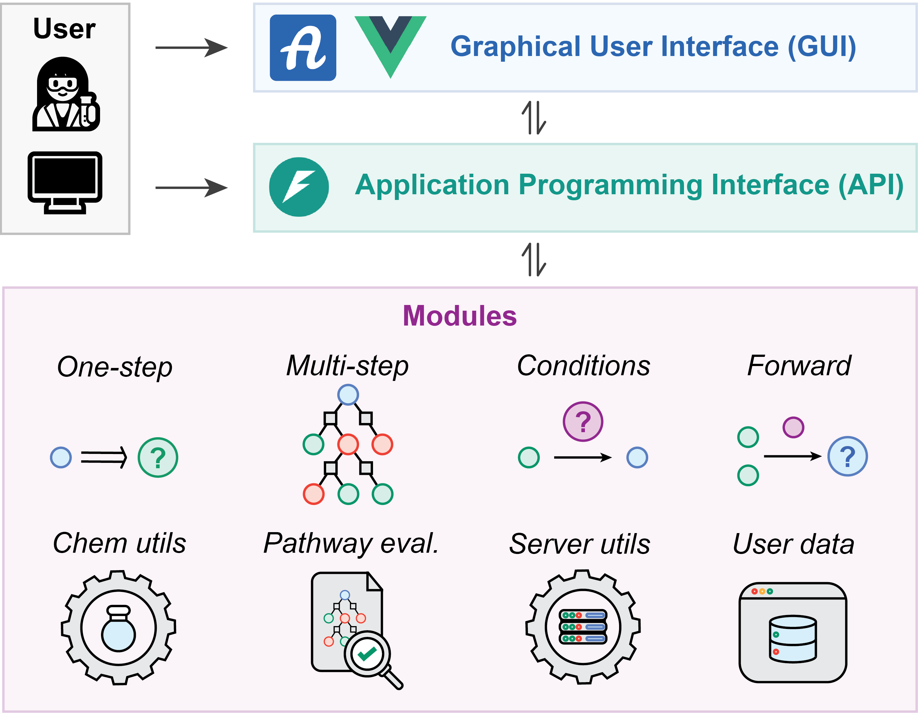
ASKCOS is microservice-based
- With Vue.js and FastAPI
- Via Wrappers
- Not a monolithic Python package (anymore)
- No dependency conflicts between services
Notes:
The latest version of ASKCOS was designed to be microservice-based, in which the user can interact with the APIs directly, or via the frontend graphic user interface.
The frontend is written in Vue and the API gateway in FastAPI.
The API gateway implements various wrappers, which are simple classes forwarding http requests to the corresponding backend services, as in the bottom left.
We did a major refactor in 2023 to turn the previously monolithic Python-based ASKCOS into a collection of microservices with a centralized API gateway,
which increased the modularization tremendously, and moreover, eliminated the possibility of dependency conflicts between the now containerized prediction services.

Slide 21
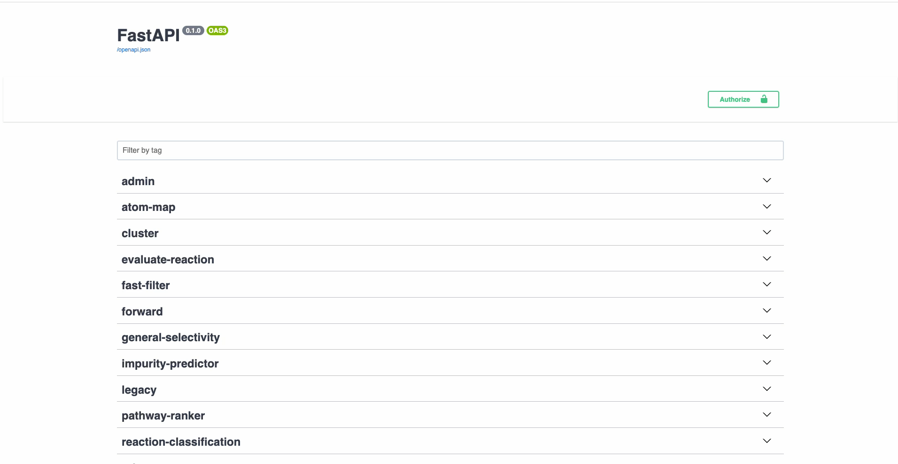
ASKCOS offers API access with auto-generated doc
Notes:
While we don’t expose API access for the public site, if you deploy ASKCOS by yourself, you will be able to access the up-to-date API documentation which is automatically generated and pre-filled with working sample queries.
Here I’ll show a quick video for the API usage.

Slide 22
Templating keeps the API gateway lightweight
# in askcos2_core/app.py, core loop for API binding
app = FastAPI()
for wrapper in wrapper_registry:
for method in wrapper.methods:
path = f"/api/{wrapper.prefix}/{method}"
endpoint = getattr(wrapper, method)
app.add_api_route(
path=path,
endpoint=endpoint
)
# in askcos2_core/wrapper/scscore/default.py
@register_wrapper(
name="scscore",
input_class=SCScoreInput,
response_class=SCScoreResponse
)
class SCScoreWrapper(BaseWrapper):
prefix = "scscore"
methods = ["call_sync", "call_async"]
def call_sync(
self,
input: SCScoreInput
) -> SCScoreResponse:
Notes:
The next few slides are going to be more exciting, as we will be seeing some real codes, reproduced from the repo for the API gateway of ASKCOS and slightly simplified for illustration.
As with all open-source projects, it is important for the code to be readable and yet lightweight in order to be maintainable and extensible.
This is especially relevant for ASKCOS, whose API gateway needs to manage quite a number of backend services which may be performing very different prediction tasks.
One of the ways we use is templating (with a bit of abuse of terminology), which means to write code in a standard format.
This is central for the implementation of the API gateway for endpoint binding, the core logic of which is shown on the left. Two simple for loops first iterate over all wrappers in the wrapper registry, and then over all methods in a wrapper, to bind those methods under the corresponding paths with the wrapper prefix and the method name.
On the right, any wrapper, such as the wrapper for SCScore here, has a standard format for definition. It is registered automatically into the wrapper registry at definition, along with the schema for its input and response classes.
If we substitute the wrapper attributes into the for loop and work things out, the outcome is that the call_sync method of this wrapper will be bound to /api/scscore/call_sync, with the input specified as a SCScoreInput dataclass object, and returning an SCScoreResponse dataclass object.

Slide 23
Templating keeps the API gateway lightweight
# in askcos2_core/config/module_config_full.py
modules_to_start = {
...
“context_recommender”: True,
“scscore”: True,
…
}
scscore = {
“repo”: “…/scscore.git”,
“deployment_config”: “deployment.yaml”,
“prediction_url”: “0.0.0.0:9741/scscore”,
…
}
# in scscore/deployment.yaml (NOT in askcos2_core)
docker:
cpu:
image: scscore:1.0-cpu
build_command: docker build ...
start_command: sh scripts/start.sh
gpu:
...
singularity:
cpu: ...
gpu: ...
...
other_commands: ...
Notes:
The templated design is not only for API binding, but also covers the configuration of all the prediction services.
Here on the left, the centralized config file keeps track of the modules to start, as well as the metadata of all modules including its remote repository, deployment config file, and prediction_url.
With this config file alone, the deployment script can become aware of things like where to clone the repos for each service, where to look for commands for building environments and starting services, as well as the prediction url to which the queries will be forwarded.
A sample deployment config for the scscore service repo is shown on the right, and it basically just stores the commands for building and starting, and maybe for downloading data if needed.
And these should already suffice to give an idea about how to extend ASKCOS by integrating arbitrary prediction service.
Just prepare a deployment.yaml in the service repo, add that into the central config on the left, defining a wrapper at the gateway, mostly by inheriting the base wrapper and some copy-and-pasting. Restart and it should become usable in the auto-generated API documentation page we’ve seen.

Slide 24
Key workflows have been abstracted away
# in askcos2_core/wrappers/__init__.py, registration
def register_wrapper(name, ...):
def register_wrapper_cls(cls):
WRAPPER_REGISTRY[name] = cls
# in askcos2_core/wrappers/base.py, collapsed view
class BaseWrapper:
def call_raw(self, input):
...
def call_sync(self, input):
...
def call_async(self, input):
...
# in askcos2_core/wrappers/base.py, expanded view
class BaseWrapper:
def call_raw(self, input):
return requests.post(..., input).json()
def call_sync(self, input):
output = self.call_raw(input)
return self.convert_to_response(output)
def call_aync(self, input) -> str:
async_result = base_task.apply_async(
args=(self.name, input))
return async_result.id
Notes:
Parallel to templating is the abstraction of key workflows, which further reduces the effort required for maintaining or adding wrappers.
As we saw from previous slide, wrappers can be thought of as being registered into the wrapper registry at definition, and the registration logic is really just declaring a global dictionary that stores the names of the wrapper and their classes.
The logics for synchronous API calls and async task managements have also been more or less standardized in the base wrapper.
To elaborate, in the expanded view on the right, the call_sync method (or equivalently the call_sync endpoint), merely forward the incoming call as another http request with the call_raw method, followed by conversion of the raw output into desired response format.
The call_async method imports some basic async task from the celery package, and passes the name of the wrapper with the input as arguments,
so that these can be processed behind the scene to use the corresponding call_sync endpoint but with a message queue, returning the task id which can be used to retrieve the results when ready.

Slide 25
Expensive sub-modules are separated out as own services
# Function call version of TreeSearch (old)
class OneStep:
def predict(in) -> List[str]:
result = run_model(in)
return result
class TreeSearch:
def __init__(self):
self.one_step = OneStep()
def expand(self, in):
self.one_step.predict(in)
# API call version of TreeSearch (new)
class OneStepAPI:
def predict(in) -> List[str]:
response = requests.post(one_step_url, in)
result = _convert_response(response)
return result
class TreeSearch:
def __init__(self):
self.one_step = OneStepAPI()
def expand(self, in):
self.one_step.predict(in)
Notes:
Those summarize the design and implementation of the API gateway of ASKCOS, with templating of the wrappers and the module configs, as well as abstractions of wrapper registration and the async workflow.
With that, you are more or less ready to become a maintainer of ASKCOS, at least for the API gateway.
This last slide on coding here is more related to the backend prediction services, each of which is individualized and maintained in a slightly more decentralized manner.
One thing that we try to enforce for these services is that if there is any function call to computationally expensive sub-modules, those should be separated out as independent services themselves.
The function calls are then replaced with API calls, via the gateway, which enhances modularization.
For instance, suppose we have a tree search class on the left, whose .expand method makes use of some expensive one_step model, with a .predict() method.
Refactoring the class to be service-based is as simple as first packaging the one step model as its own service, then defining or redefining a one step API class as on the right, and using HTTP requests in place of function calls.
In this way, modularity is enhanced, while keeping the tree search module somewhat clean and lightweight, without having to include all of the dependencies of the one step model
The backend services are generally not as consistent as their contributors are mostly free to do whatever they want, but maintaining them is not too different from maintaining repos for any machine learning models.

Slide 26
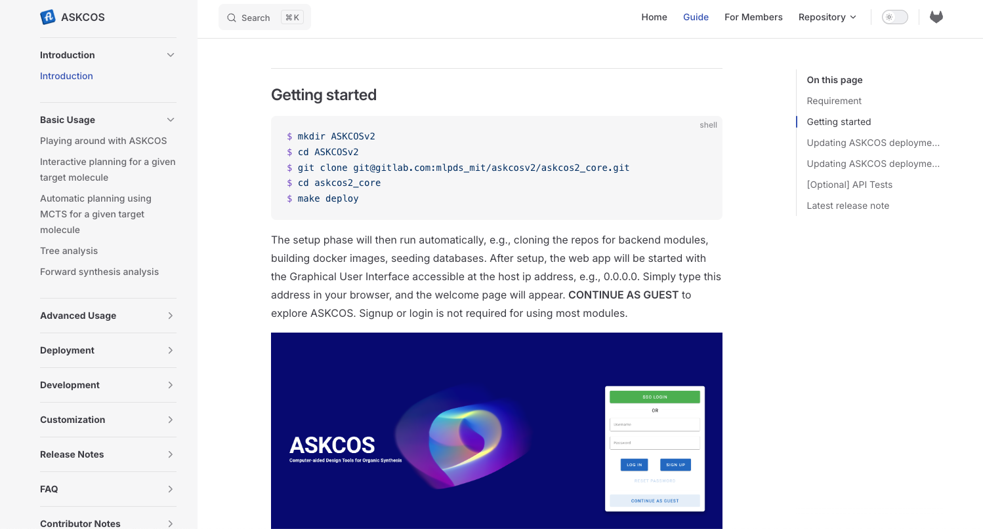
ASKCOS has extensive documentation
askcos-docs
Searchable
Continuously
updated
Notes:
ASKCOS has been extensively documented at askcos-docs.mit.edu, and it should also pop up if you simply search for askcos-docs.
The getting started section provides the exact five lines for quick deployment as we see earlier, and the documentation covers the basic and advanced usage,
deployment consideration including detailed instruction for partial deployment, development note including how to turn your code into microservices, and more.
The doc website is searchable and it is being continuously updated.
In that sense it will never be completed, but please let us know if something is inconsistent or missing.

Slide 27
Thoughts and reflections
ASKCOS is meant to put together research advances into a practical, usable tool
- to assist, and not replace chemists
Many ASKCOS modules are (and will probably remain) data-driven
- support for easy retraining is important
- we found PyTorch + Torchserve suitable; a model archive (as a .mar file) suffices for serving from anywhere
Not all models are deployment-ready
- RAM usage can be high; it can spike too
- Retraining (without reimplementation) can take long when scaled up
ASKCOS makes heavy use of RDKit and we hope to build a community with ASKCOS
- though right now “I’m kind of afraid of having more users”⁹
Notes:
Just to emphasize, ASKCOS is meant to put together research advances into a practical, usable tool, and to assist and never to replace chemists.
Many ASKCOS modules are and will probably remain data-driven. We didn’t go through retraining in the presentation but it is supported, for some modules,
Serving and/or retraining certain modules can be challenging, for example, with high or spiking RAM usage and long retraining time with the original implementations. We can feel the gap between research and development but that’s exactly what we are trying to bridge with ASKCOS.
And last but not least, a special thank for RDKit and its community from which ASKCOS has benefited a lot.
We are at a relatively early stage for building an ASKCOS community, which is hard, especially with irregular manpower as is typical for open-source projects. And any suggestions or feedback will be much appreciated.

Slide 28
ASKCOS is actively developed and supported
The ASKCOS team
Zhengkai Tu
Mun Hong Fong
Huiqian Lin
Mark Murnin
Jihye Roh
Prof. Connor Coley
Coley Research Group
MLPDS Consortium
Hall of fame
Sourabh J. Choure (Amazon)
Max Liu (AstraZeneca)
Mike Fortunato (Novartis)
Thomas Struble (BMS)
Yanfei Guan (Pfizer)
Pritha Verma (AbbVie)
Hanyu Gao (HKUST)
Yiming Mo (ZJU)
Thijs Stuyver (Chimie)
…and many more
Notes:
With that, I’d like to thank the ASKCOS team for ongoing development, active users from the Coley Research Group and the MLPDS Consortium for valuable feedback and suggestions,
and many past developers, in the hall of fame, who collectively transformed ASKCOS into its current form.

Slide 29
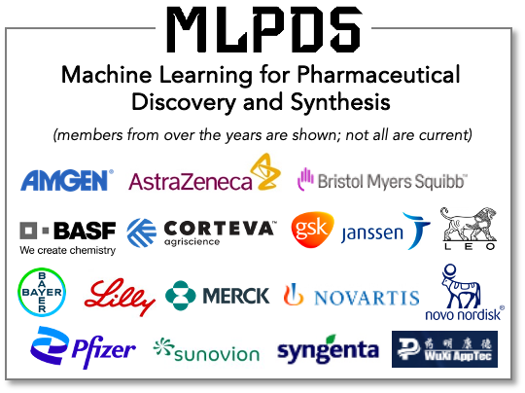







Thanks to our sponsors and data providers
Notes:
We would also like to thank our sponsors and collaborators, in particular, NextMove Software, CAS, and Reaxys for providing data, on which a few of our data-driven models have been trained.

Slide 30
Thank you! Try ASKCOS at askcos.mit.edu Contact us at askcos_support@mit.edu
For the slides
For the manuscript
Notes:
We have a more extensive preprint with the QR code here, which is a manuscript version of this presentation, with more elaboration on ASKCOS formulation, contextualization, as well as usage from the perspectives of end users.
Please feel free to contact us at askcos_support@mit.edu for anything.
That’s the end of the ASKCOS presentation, and thanks for your attention!

Slide 31

Gabe Gomes to present virtually

Slide 32
2:45 – 3:00 break!

